Slide 1
Network Security (CSE 350)
Assignment-1
Prof. B.N. Jain
Project 1 : Poly-alphabetic substitution
Algorithm:
(1363+1362)%3=1
Submitted by:
Name Roll No
Vansh 2021363
V. Bharath Krishna 2021362

Slide 2
Brief Overview of Project
Programming Language: C++
Platform: MS Windows
We have implemented a Poly-Alphabetic substitution system using a symmetric
Key of known length 4. We implemented 6 functions named check_string, encrypt,
Decrypt, hash, recognizable, bruteforce.
The character set consists of lower case English letters, viz. {a, b, …, z}.
We take input for key from key.txt file, 5 sample input for original string from Original_texts.txt.
We check if the key and original string are strings of lowercase English alphabet or not in the
Check_string function using the islower() in-built function.
Plaintext is formed by concatenating the original text and the hash value of original text using the hash()
Function by means of “+” operator.
The encrypt() and decrypt() and Hash() function results are calculated and visually inspected.
We have also done error handling while reading from the file.
At last bruteforce function is called to find the key and is printed on terminal.

Slide 3
Hash Function
Returns a 16 character string called hash_string which is the hash_value of the original string passed as
A parameter. Each character of the original string is placed in a 16 column matrix. The blank elements
After the last character in the last row are marked as the character “z”. Then we add the integer ASCII
value of every character in a column for all 16 column. Then the 16 integer values are converted into a
character by taking its modulo with 26 and adding 97 and assigning the integer to a character. The string
of 16 characters in order is returned as hash_value of the original string.
Example:
Original String : thisisthefourthsampleinput
t | h | i | s | i | s | t | h | e | f | o | u | r | t | h | s
a | m | p | l | e | i | n | p | u | t | - | - | - | - | - | -
t | h | i | s | i | s | t | h | e | f | o | u | r | t | h | s
a | m | p | l | e | i | n | p | u | t | z | z | z | z | z | z
1st row
2nd row
Integer ASCII of 1st row
116 | 104 | 105 | 115 | 105 | 115 | 116 | 104 | 101 | 102 | 111 | 117 | 114 | 116 | 104 | 115
97 | 109 | 112 | 108 | 101 | 105 | 110 | 112 | 117 | 116 | 122 | 122 | 122 | 122 | 122 | 122
213 | 213 | 217 | 223 | 206 | 220 | 226 | 216 | 218 | 218 | 233 | 239 | 236 | 238 | 226 | 237
102 | 102 | 106 | 112 | 121 | 109 | 115 | 105 | 107 | 107 | 122 | 102 | 99 | 101 | 115 | 100
Integer ASCII of 2nd row
Addition (+)
Addition%26 +97
Converting integer
ASCII To char
f | f | j | p | y | m | s | i | k | k | z | f | c | e | s | d

Slide 4
Encryption Function
key
h | i | g | h | h | i | g | h | h | i | g | h | h | i
7 | 8 | 6 | 7 | 7 | 8 | 6 | 7 | 7 | 8 | 6 | 7 | 7 | 8
t | h | i | s | i | s | a | e | x | a | m | p | l | e
a | p | o | z | p | a | g | l | e | i | s | w | s | m
numeric key
plaintext
ciphertext
In the above example, we are encrypting the plaintext using the key=“high” .
We generate the numeric key by subtracting 97 from the integer ASCII value of
the respective character from the key in the column (h=104-97=7). For encrypting,
we shift each character in the plaintext forward by the respective integer in the
numeric key row. In the example above, we can see that the characters of key are
repeated till the length of plaintext.

Slide 5
Decryption Function
key
h | i | g | h | h | i | g | h | h | i | g | h | h | i
numeric key
7 | 8 | 6 | 7 | 7 | 8 | 6 | 7 | 7 | 8 | 6 | 7 | 7 | 8
ciphertext
a | p | o | z | p | a | g | l | e | i | s | w | s | m
plaintext
t | h | i | s | i | s | a | e | x | a | m | p | l | e
In the above example we are decrypting the ciphertext using the key=“high”.
For Decrypting we shift each character in the ciphertext backwards by the respective
Integer in the numeric key row. In the example above, we can see that the characters
of key are repeated till the length of plaintext.

Slide 6
Recognizable function and Pie Property
Recognizable function takes plaintext as parameter and returns a bool variable whether
the plaintext is recognizable or not. Or in simpler words, the plaintext satisfies the pie
property or not.
Pie property for a plaintext :
Last 16 characters of plaintext == Hash (Remaining characters of the plaintext)
It is useful to check If the key used to decrypt is correct or not. For example if we can
have many combinations of key and each key resulting in a plaintext. How to know which
key is correct?

Slide 7
BruteForce
In this function, we try to crack the key by launching a bruteforce attack.
We iterate from “aaaa” to “zzzz” to select a key and for every key, we decrypt the
first ciphertext and check if the resulting first plaintext is recognizable or not using
the recognizable() function.
If the first plaintext is recognizable, we do the same thing
for all 5 ciphertexts. If the chosen key holds true for all 5 ciphertext, we return the
key found. Else we drop this key and repeat this process for a new key. If no key is found,
the function returns “ERROR”.

Slide 8
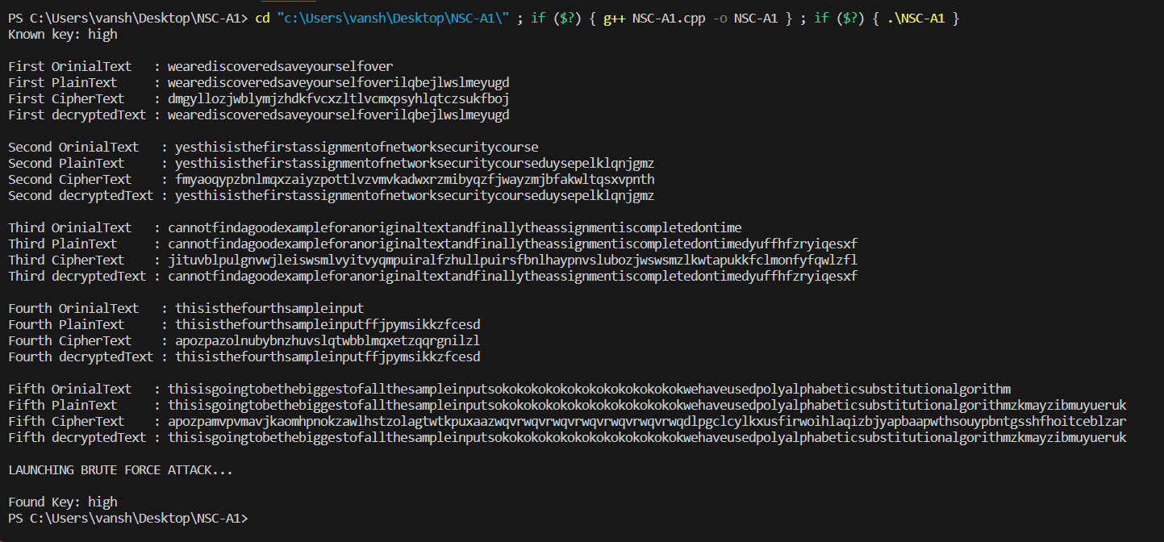
Sample Input/ Output

